Slide 1
Introducing Classes

Slide 2
Agenda
Concept of class
Creating objects
Declaring objects
Methods
Returning a value
Parameterized methods
Constructors
Garbage Collection

Slide 3


Concept of Class
A class is a description of a group of objects with common properties (attributes) & behavior (operations)
An object is an instance of a class
e.g. Mary is an object of Student class
Jane is an object of Student class
Mary 1001
Jane 1002
name
rollNo
name
rollNo

Slide 4
General form of a Class
class classname
{
type instance-variable1;
type instance-variable2;
// ...
type instance-variableN;
type methodname1(parameter-list) {
// body of method
}
type methodname2(parameter-list) {
// body of method
}
// ...
type methodnameN(parameter-list) {
// body of method
}
}

Slide 5
General form of a Class
Data and variable defined within class are called instance variable
The code is contained within methods
Collectively, the methods and variables defined within a class are called members of the class
In most classes, the instance variables are acted upon and accessed by the methods defined for that class.
Thus, as a general rule, it is the methods that determine how a class’ data can be used
Class is a template for an object and an object is an instance of a class.
Java classes do not need to have a main() method.

Slide 6
Creating an object
A class declaration only creates a template, it does not create an actual object.
There are three steps when creating an object from a class:
Declaration: A variable declaration with a variable name as an object type.
Instantiation: The 'new' key word is used to create the object.
Initialization: The 'new' keyword is followed by a call to a constructor. This call initializes the new object.

Slide 7
Creating Objects
The new operator creates a object & returns a reference to it
Memory allocation of objects happens in the heap area
Reference returned can be stored in reference variables
Student obj1;
obj1 = new Student();
Or
Student obj2 = new Student(“John”);
Declare reference to object
obj1 is a reference variable
Allocate a “Student” object
obj1: Student
obj2: Student
new keyword creates an object and returns a reference to it
name
name
John
Notes:
The new keyword is used to create new objects in Java. Creating an object involves allocating memory to the object that is created.
If we just declare the following :
MyMath myMathObject;
Only a reference called myMathObject of type MyMath is created. No memory is allocated for the same. Its only when we use the new operator, memory is allocated, and the reference points to the memory that is allocated to the object.
If the class definition has multiple constructors, then those constructors can be invoked as shown in the slides above.

Slide 8
Declaring Objects
The new operator dynamically allocates (that is, allocates at run time) memory for an object and returns a reference to it.
After first line, the “obj1” contains value null, which indicates that it does not yet point to an actual object. Any attempt to use “obj1” here results in compile time error.
The next line allocates an actual object and assigns a reference to it to “obj1”
Now “obj1” can be used as object of “Student”
Initializing other variables like int, short, char etc does not need new keyword as they are not classes
If new can not allocate memory, it generates exception

Slide 9
Constituents of a Class
Data Members (State)
public class Student {
private int rollNo;
private String name;
Student(){
//initialize data members
}
Student(String nameParam){
name = nameParam;
}
public int getrollNo (){
return rollNo;
}
}
Constructor
Method (Behavior)
The main method may or may not be present depending on whether the class is a starter class
Naming Convention → Class Name: First letter Capital
Notes:
The class defines a new data type and this data type is used to create objects of that type. “class is an template for an object”.
Following is the general from of the class:
class MyClass
{ variable1;
variable2;
Method1()
{ // Body of Method1.
}
Method2(parameters)
{ //Body of Method2.
}
}
Usually, data members will be kept private and methods accessing the data members will be kept as private. We will revisit this concept when we talk about ‘access modifiers’ in the later slides
A helper method is a method that helps another method to perform it's task. These are typically used when a method has to perform a complicated task that is composed of several smaller tasks. The smaller tasks are often performed by helper methods.

Slide 10
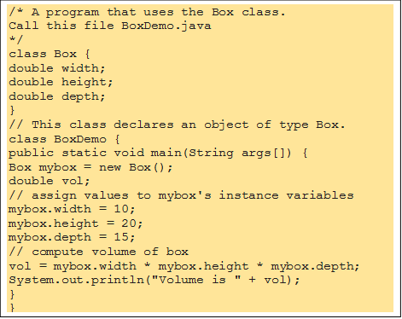
A simple Class

Slide 11
Objects of Box class

Slide 12
Assigning object reference variable
The assignment of b1 to b2 did not allocate any memory or copy any part of the original object. It simply makes b2 refer to the same object as does b1.
Basically they are same object with different names
However they are not linked in any way. A subsequent assignment to b1 will simply unhook b1 from the original object without affecting the object or affecting b2. For example
When you assign one object reference variable to another object reference variable, you are not creating a copy of the object, you are only making a copy of the reference.

Slide 13
Methods
type name (parameter-list) {
//body of method }
type specifies the type of data returned by the method. This can be any valid type, including class types that you create.
If the method does not return a value, its return type must be void. The name of the method is specified by name.
Parameters are essentially variables that receive the value of the arguments passed to the method when it is called. If the method has no parameters, then the parameter list will be empty.
Methods that have a return type other than void return a value to the calling routine using the following form of the return statement:
return value;
Here, value is the value returned.

Slide 14
Accessing Instance Variables and Methods
/* First create an object */
ObjectReference = new Constructor();
/* Now call a variable as follows */
ObjectReference.variableName;
/* Now you can call a class method as follows */
ObjectReference.MethodName();

Slide 15
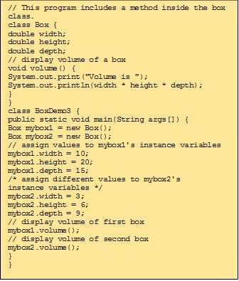
Adding a method to a Class

Slide 16
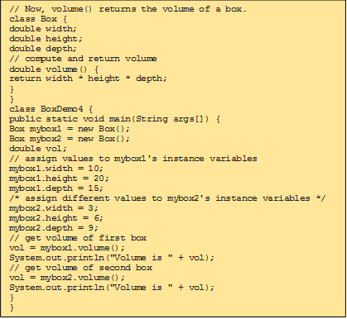
Returning a value

Slide 17
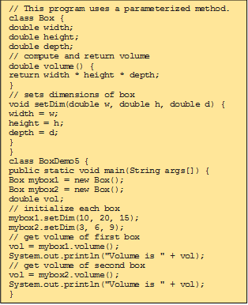
Parameterized Methods

Slide 18
Constructors
Special methods used to initialize a newly created object
Called just after memory is allocated for an object
Initialize objects to required or default values at the time of object creation
Not mandatory to write a constructor for each class
A constructor
Has the same name as that of the class
Doesn’t return any value, not even void
May or may not have parameters (arguments)
If a class does not have any constructor, the default constructor is automatically added
In the absence of a user defined constructor, the compiler initializes member variables to its default values
Numeric data types are set to 0
Char data types are set to null character (‘\0’)
Reference variables are set to null

Slide 19
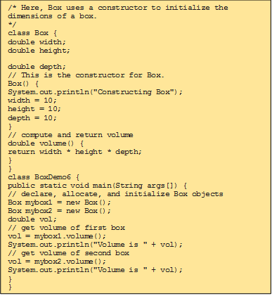
Constructors

Slide 20
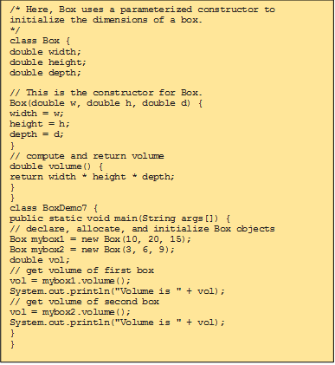
Parameterized Constructors

Slide 21
Garbage Collection
Garbage collection is the process of reclaiming the unused memory space and making it available for the future instances.
Objects are dynamically allocated by using the new operator.
In C++, dynamically allocated objects must be manually released by use of a delete operator.
In C, it is the programmer’s responsibility to de-allocate the dynamically allocated memory using the free() function.
Java takes a different approach; it handles deallocation for you automatically.
When no references to an object exist, that object is assumed to be no longer needed, and the memory occupied by the object can be reclaimed.
The garbage collector runs periodically, checking for objects that are no longer referenced by any running state or indirectly through other referenced objects.
There is no explicit need to destroy objects as in C++.
Normally a programmer should not think about destroying objects in java.

Slide 22
How can an object be unreferenced?
By nulling the reference
Employee e = new Employee();
e = null;
By assigning a reference to another
Employee e1 = new Employee();
Employee e2 = new Employee();
e1 = e2; //now the first object referred by e1 is available for garbage collection
By anonymous object etc.
new Employee();

Slide 23
finalize() method
Sometimes an object will need to perform some action when it is destroyed
For example, if an object is holding some non-Java resource such as a file handle or character font, then you might want to make sure these resources are freed before an object is destroyed
You can define specific actions that will occur when an object is just about to be reclaimed by the garbage collector
Right before an asset is freed, the Java run time calls the finalize() method on the object
protected is a specifier that prevents access to finalize() by code defined outside its class
It is important to understand that finalize() is only called just prior to garbage collection. It is not called when an object goes out-of-scope
Garbage collection is performed by a daemon thread called Garbage Collector(GC). This thread calls the finalize() method before object is garbage collected.

Slide 24
THANK YOU!!
ANY QUESTIONS??

